Slide 1
CYBERSECURITY DAYSCHOLARS KILL PROTECT TEAM -3 CALORIES BURNT PREDICTION
A Guide to Consumption and BurnUnderstanding Caloric

Slide 2
4.NARKADAMILLI LAKSHMI KOUSTUBHA Roll No: 23B21A4609 5.THOGARU HARENDRA NAIDU Roll No: 24B25A4604 6.GARAGA SIVA DURGA Roll No:23B21A4638
1.YANAMADALA LEHAR DHANA SAI KUMAR Roll NO: 23B21A4637 2.KOLA VEERA VENKATA SATISH Roll NO:23B21A4632 3.GUTHULA TEJASWINI Roll No:24B25A4616
TEAM MEMBERS

Slide 3
INTRODUCTION:
*PROBLEM STATEMENT*:- Predict calories burned during exercise based on activities and weight.
*OBJECTIVE*:- Use machine learning to provide accurate calorie predictions to assist in fitness planning.
*RELEVANCE*: Helps users track fitness progress and plan workouts effectively.

Slide 4
ALGORITHMS USED
LINEAR REGRESSION
----Predicts calories burned as a linear function of activity and weight.
WHY LINEAR REGRESSION?
---- Simplicity and interpretability. - Suitable for linearly separable data.

Slide 5
--- Used Multilabelbinarizer To Encode Categorical Activity Data Into Numerical Format. --- Combined Encoded Activities With Weight As Features. ---Split Data Into Training (80%) And Testing (20%) Subsets.
DATA PREPROCESSING

Slide 6
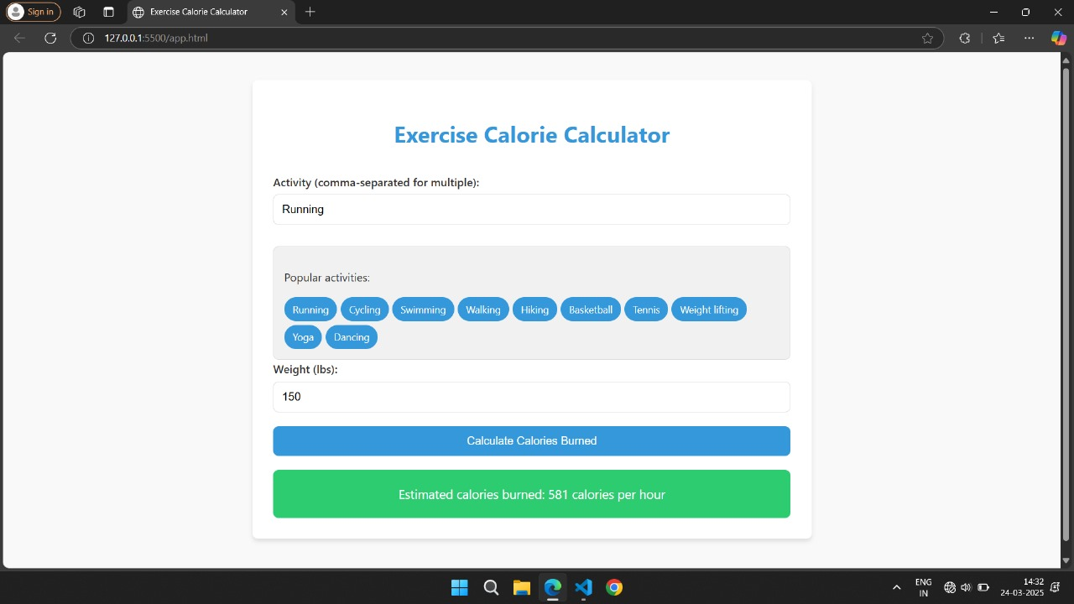
.

Slide 7
CONCLUSION:
Summarized the project workflow from data preprocessing to model deployment
.- Highlighted the importance of machine learning in fitness tracking and health management.

Slide 8
Thank you!
Do you have any questions?
+91 620 421 838

